Slide 1

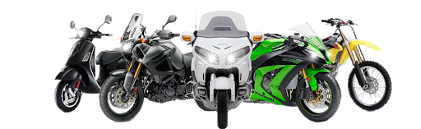

Automobiles MANAGEMENT SYSTEM.
…A New Way Of Vehicle Management…

Slide 2
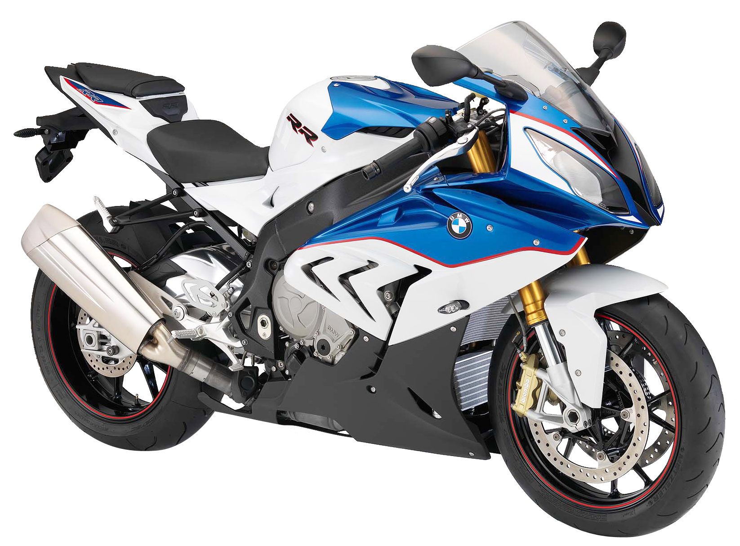
Project member’s details:
Crew Member’s: Kalaiyarasan.S , Daniel Martel.A , Aravind Kumar.S
College: Manakula Vinayagar Institute Of Technology.
Year: III.
Department: Computer Science & Engineering.
Section: ‘B’.
Semester: V.
Submitted On: 03/10/2020.
Submitted To: Ass.Prof.Mr.Ashok Kumar

Slide 3

Abstract:
Vehicle Management System has three types of users Manager[Admin], Employees, and Users. There is only one Admin in this software.
The software is intended to do two major tasks i.e. Booking Management and Fleet Management.
Booking Management keeps track of all the vehicle bookings related transactions. It includes New Vehicle Registration, Listing Vehicles, Checking Availability, Booking Vehicles, Booking Cancellation, Fare Calculation, Booking History.
While Fleet Management keeps track of vehicles. It includes Repair and Maintenance Logs, Fuel Logs, Lubricant Logs, Distance Logs, Parts Changed Records and Vehicle Ratings.
It also keep track of expenses and bills of the company. Daily Reports can be generated on the basis of these input data collected by Bookings and Fleet Management Modules. User may also print these details if he wants to. It has a Feedback Module where customers of the company can give their feedbacks. A customer can also Rate a vehicle if he had booked it in past . Different types of users have different privileges to the software. Admin has the maximum access to the software.

Slide 4
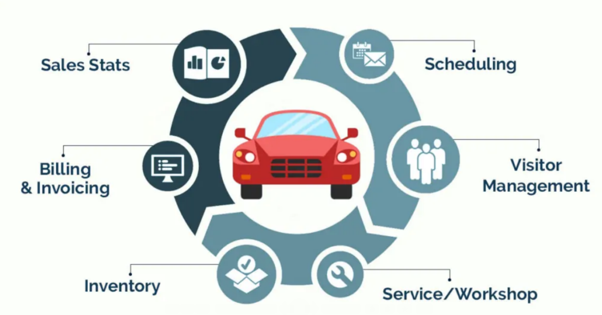
objectives/Scope of the Project:
Vehicle Management System is a windows application which aims to minimize the effort put in company to maintain their transactions. It manages all the transactions related to Vehicle profiling, Vehicle Bookings, Fleet management, Booking Details, Daily Expenses, Daily Reports and Customer Feedbacks of the company.
In this software, There is an Admin. Admin can add new users to the system. Guest can use the software only after they are registered to the system.
While Register, A Guest User can register as
Manager(ADMIN),
Employee,
Customers.

Slide 5
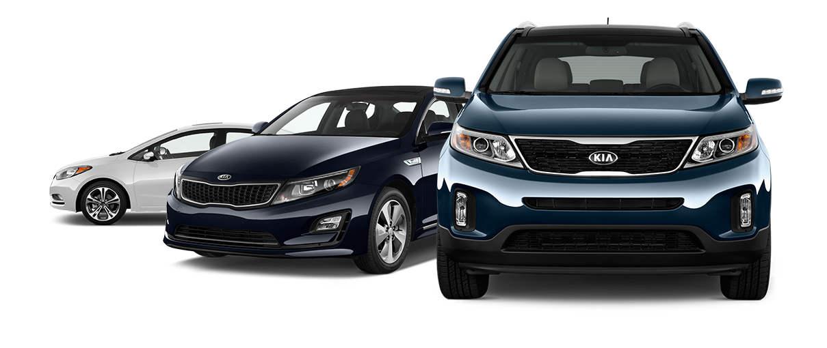
Modules involved:
There are basically 8 modules in this software :
Login/Registration ,
Profiles,
Vehicles ,
Booking Management,
Fleet Management,
Expenses ,
Reports ,
Feedback ,

Slide 6

User interface design: ADMINISTRATOR USER FUNCTION:
In this functionality the administrator will do his own responsibilities. Whenever he needs to change the Password, then he can directly change it.
If any reason he needs to add a new user he can directly add.
The admin user can view the details of all the users .
He can view the details of all the employees of the company and any time he can add or remove any particular employee or employees.
This application mainly concentrated about the transport. The admin user can view the details of all the categories of the transport. This categories viewing list has shows the ID Number of the category, how much amount per month, all these information will be provided.
The admin user can view the details of all the vehicles details which are presently using in the particular company.
In this list also each and every vehicle has its own identification number, registration number of the particular vehicle, and the type of the vehicle either it is own.
The administrator can add the vehicle depends upon the situation of the company.

Slide 7
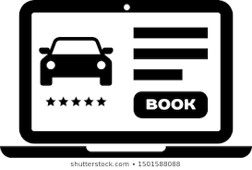

Booking Functions:
In this function, the Transport user can enter into his functionality using his own User ID and Password.
After entering into his functionality, whenever he needs to change his password then he can directly change it.
The Admin can view the details of all the users and the employees of the company.
The user can view the details of all the vehicles.
The transport user can view the details of all the vehicle requests which are posted from the employees of the company.
After his careful verification only he can provide the transport facility to the requested employee.
He can add or remove the request of the employee.

Slide 8


User Functions:
In this Function, User could register to the software. He can see the listed vehicles available on the application with full description.
He can book vehicle if he wishes to and also post his vehicle on rent by registering it on the application.
After clicking on the vehicle name he gets the full information about the vehicle which he could use to make his decision according to his choice of vehicle and location of the vehicle.
Admin has full access to the fleet management, bill management, daily reports, expenses, cancellations and refunds functionalities while other users could only access the transport functionality.
Employees could additionally access expenses and daily reports sections while drivers could access fleet management and expenses functionalities of the application.

Slide 9
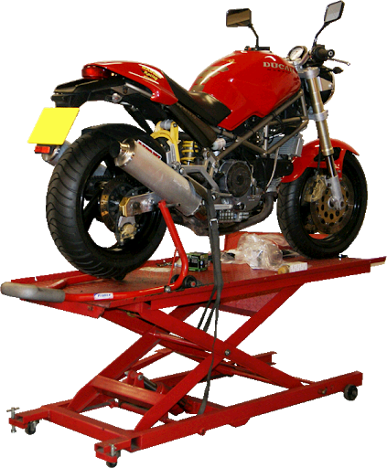
Fleet Management Functions:
This Function acts as the back bone of the Vehicle management system. It mainly has
Service Logs
Lubricant Logs
Distance Logs
Repair and Maintenance
Parts changed records
Vehicle Rating
In Service Logs, Admin and Employee can View and Add the Service Interval details along with bill details to the system.
In Lubricant Logs, Admin and Employee can View and Add the Lubricant consumption details along with bill details to the system.
In Distance Logs, Admin and Employee can View and Add the Distance travelled by the vehicle and its fuel efficiency. It helps in determining the vehicle rating.
Repair and Maintenance Logs keeps the track of Repair and Maintenance History and coming Schedules for all the vehicles and Parts Change Records keeps the track of changed parts of vehicles.
Vehicle Rating are generated for all the listed vehicles on the basis of fuel efficiency, Aging and User Reviews.

Slide 10
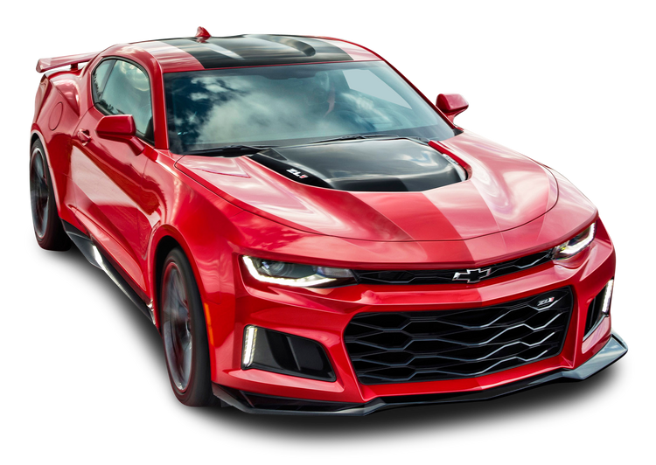
Bill Management Functions:
This function is accessible only to admin and employees.
It keeps the soft copy of all the expenses made by the company.
Admin, Employees and Drivers can add soft copies of the bills while entering the expenses for proof while only admin has the privilege to see the soft copies at any time if he needs to.
It offers
View Bills
Search Bill
Print Bill

Slide 11

Reports Management Functions:
Reports Module keeps the tracks of different transactions made by the company.
It enables user to save and print the required information generated by the software after analysis.
Admin and Employee has the privilege to view Reports. It has Menu Options
View Expenses
View Fuel Logs
View Repair & Maintenance Logs
Reports are generated on daily basis hence View Reports by Date option is available in this module.

Slide 12

Feedback Management Functions:
Feedback Function has three main parts
Give Feedback
Check Feedback
Rate a Vehicle
In Give Feedback, Only a User can submit its feedback to the system.
In Check Feedbacks, Admin and Employee both can check feedbacks submitted by the user along with user id, Date and Time of submission.
In Rate a Vehicle, Admin and User both can rate a vehicle. This rating affects the overall Rating of the vehicle.

Slide 13
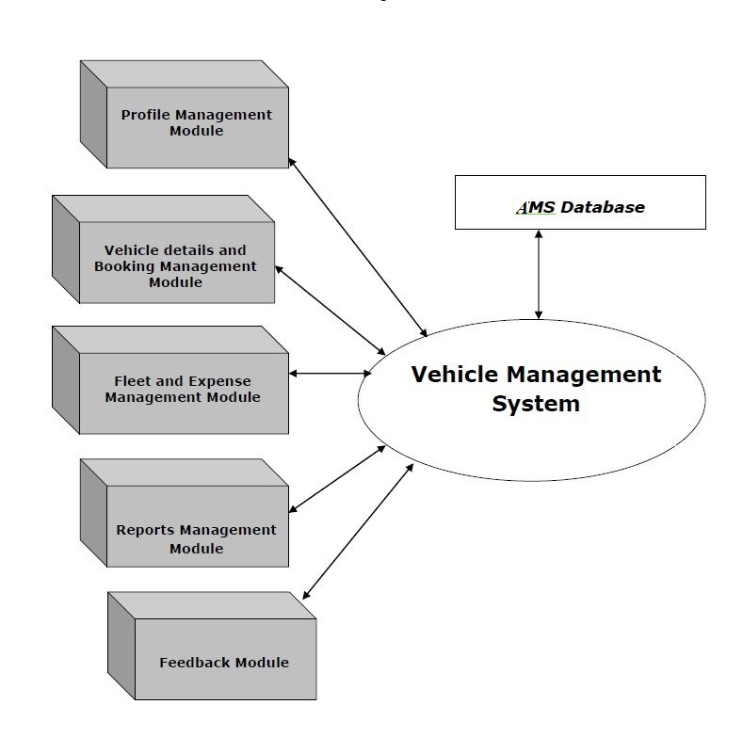
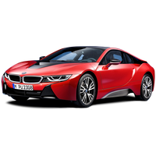
System architecture/Block diagram:

Slide 14
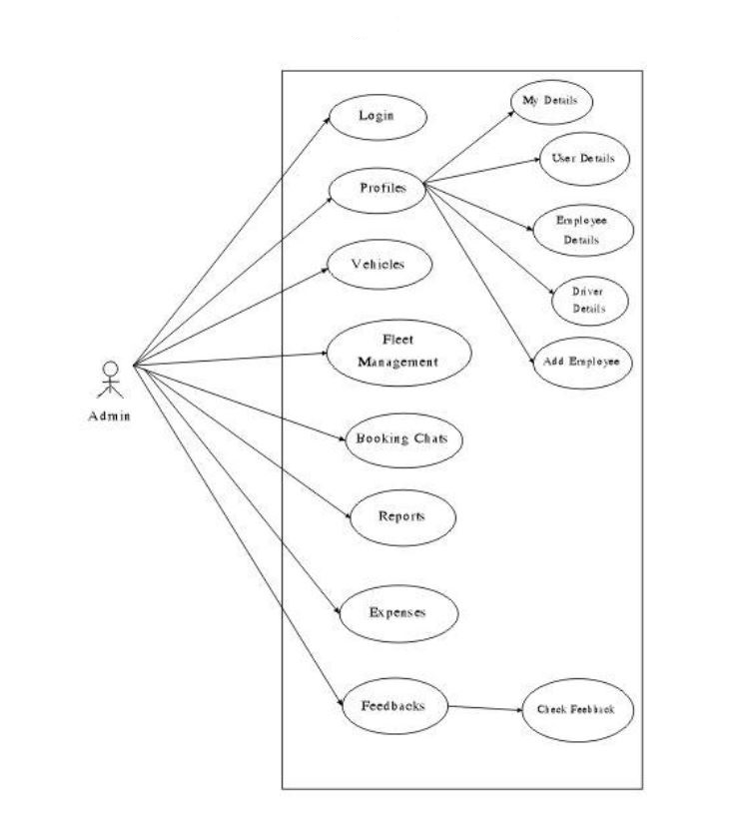
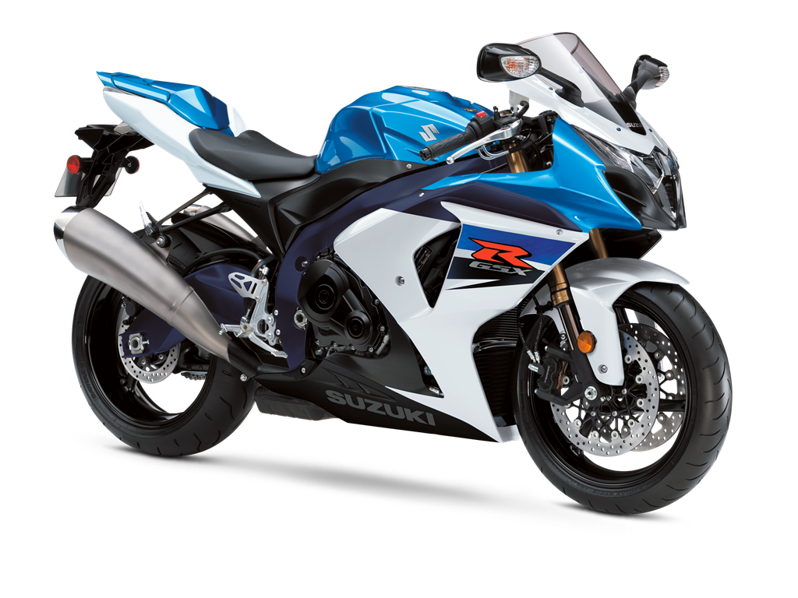
Use case diagram: admin:

Slide 15
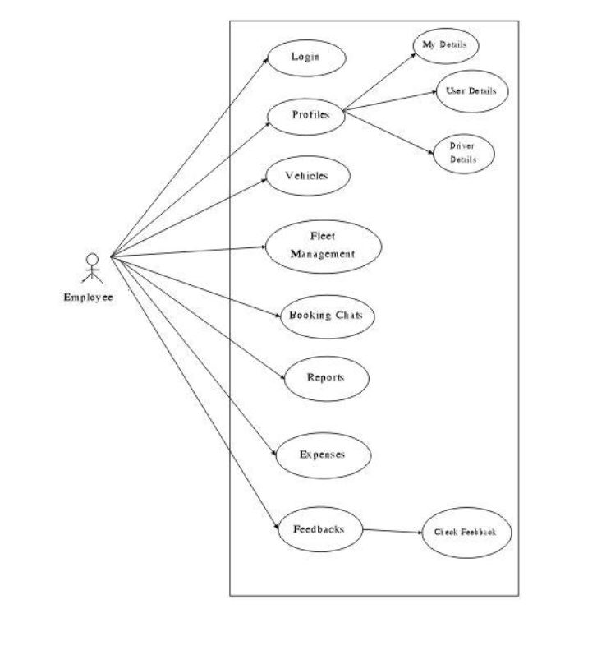
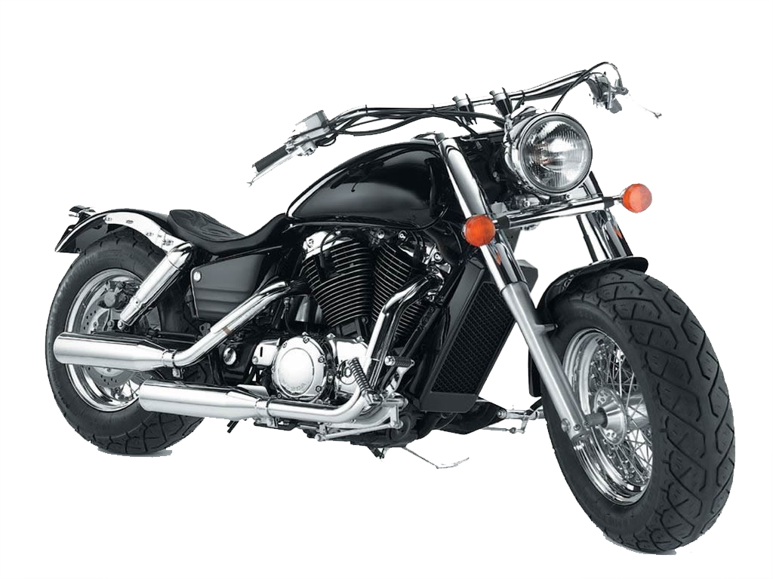
Use case diagram: Employee:

Slide 16
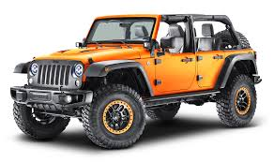
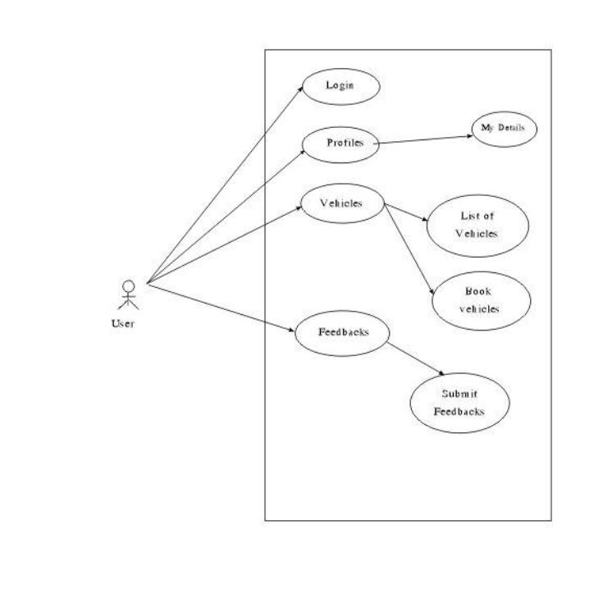
Use case diagram: user:

Slide 17
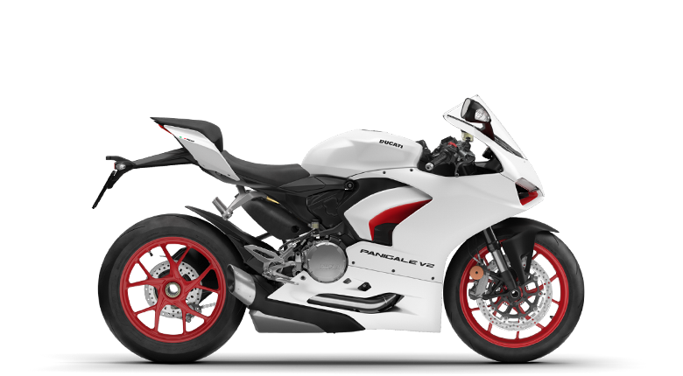
Programming languages required:
DataBase: MySQL.
Tools: Phyton,Xampp,HTML.
Front End: Phyton,HTML.
Back End: MySQL Database.

Slide 18
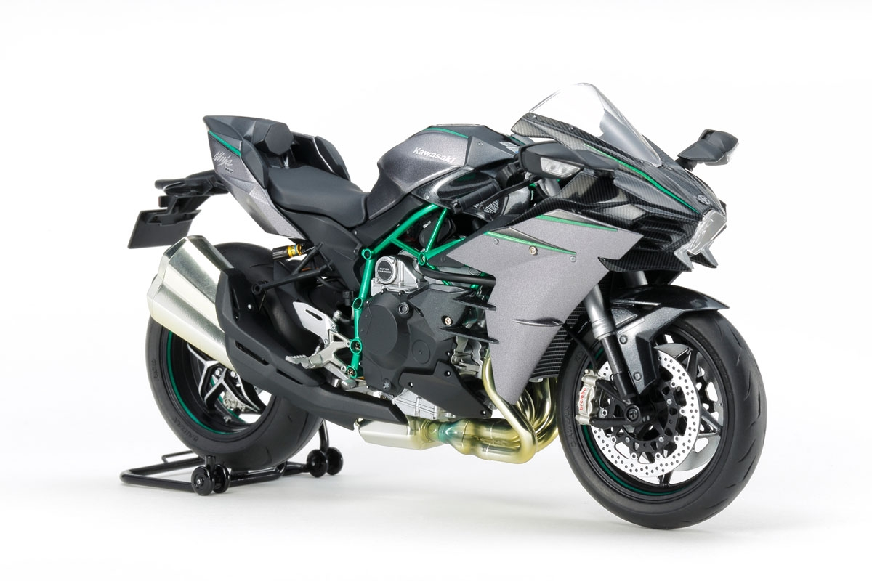
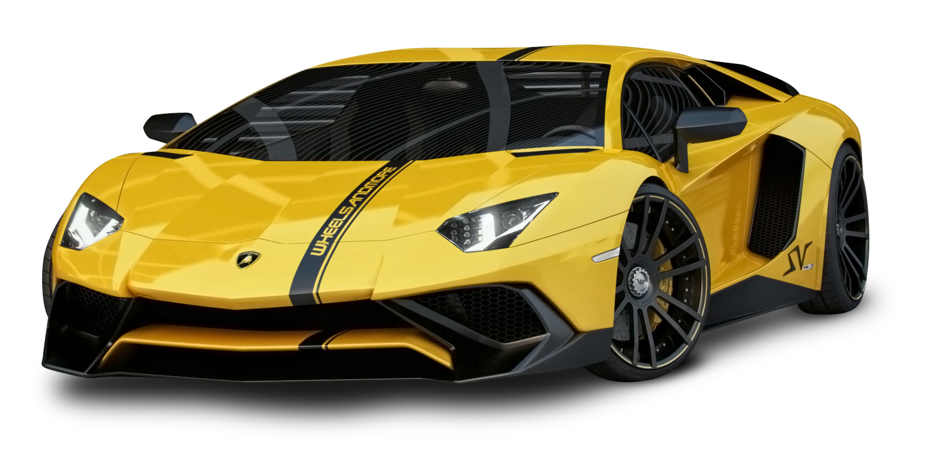
Thank you

